Slide 1

Modeling IV

Slide 2
Introduction
Instructions
Download Tutorial 13 Zip
Unzip Folder
Required Packages
Open .Rmd File and Knit
library(tidyverse)
library(modelr)
library(xtable)

Slide 3
Part 1: Cross Validation
Previously
Split Data in Train and Test
Train (28 Rivers)
Test (3 Rivers)
Purpose
Estimate Out-of-Sample Error
Pick Best Model Based on This Estimate
Combat Overfitting
Robustification
Goal: Find the Simplest Model that Adequately Predicts

Slide 4
Part 1: Cross Validation
Current Issues
Decision on Final Model Heavily Influenced by the Test Data
Loss of Data in Model Fitting
Not Appropriate in Small Datasets
Cross Validation Idea
Split Data Into Many Groups
Each Group Acts as a Test Set
All Data is Used in Both Model Fitting and Model Testing
Help: Chapter 5 (ISLR)

Slide 5
Part 1: Cross Validation
Tidyverse Concepts
Chapter 20 (R4DS)
List-Columns
Columns in Data Frames or Tibbles Can Be Lists
What this Means
Column of Tables
Column of Models
Column of Functions
Functions
nest(): Converts Rows of a Data Frame into a List
unnest(): What do You Think It Does?

Slide 6
Part 1: Cross Validation

Slide 7
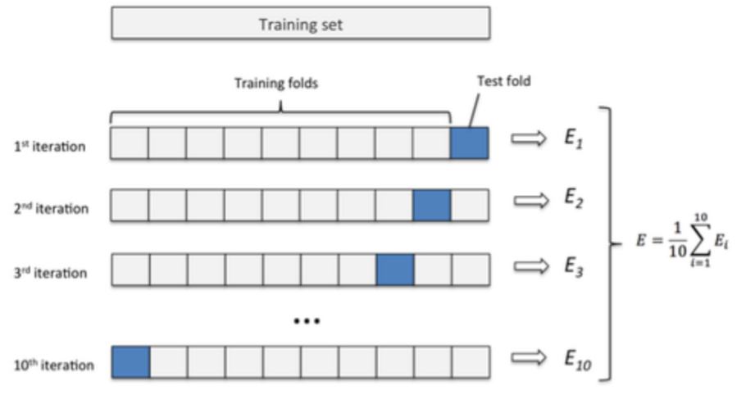
Part 1: Cross Validation
Previously
Split Data in Train and Test
What is the Purpose of This?
Understanding Cross Validation

Slide 8
Closing
Disperse and Make Reasonable Decisions

